Slide 1

Faculty of Engineering
Department of Computer Engineering
Graduation Project 2
Computer Based Lottery
Name & Surname : Nader Dali
Student number : 184459
Department : Computer Engineering
Supervisor : Mr. Zafer Erenel

Slide 2
Agenda
What is CBL
Why CBL is different
Method
Security
Conclusion
Future Work

Slide 3


What is CBL
Computer based Lottery is a website designed for anyone above the age 18 to enter and use whenever and wherever they want.
The purpose of this project is to make people gamble and try their chances and try to win some money.
I’m making this project to make people happy and reduce the stress they had that day , increase their social networking and to make them relaxed and comfortable with my website
Since it is accessible anywhere and at any time, online gambling has become more popular and well-known over the past two years. People find it to be more effective and efficient than going to casinos.

Slide 4
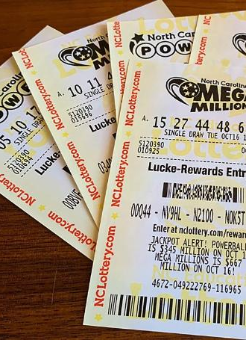
Why is CBL different
This project is different from most other gambling website because it uses crypto currency, either for purchasing tickets or the winnings.
Computer Based Lottery is a gambling website where a 100 tickets are sold each draw and at the end of the draw, it selects a random winner.
Each draw will be 30 minutes.
There will always be a winner at each draw.
The winnings will transfer directly to the winner's account.
The main Idea of this project is for entertainment only

Slide 5

Method
Tools Used for in the Computer Based Lottery :
Html : I used it to structure the website
JavaScript : I used it for the web development
Tailwindcss : need it to apply pre-existing classes in my html
Solidity : Implementing smart contracts
Third-Web : Used to connect the website to this framework so basically , I used it as my database
Metamask : Used this software to interact with the crypto currency

Slide 6





Security

Slide 7

Security in CBL
Depends on 3 main Security Services :
Confidentiality : Keep the cleint information private
Integrity : ethical standards to ensure the clients safety
User Authentication/Authorization : the procedure for limiting user access through the use of assigned roles and privileges

Slide 8

Future Works
Make new ideas in the online gambling industry
Imporve the website
Legalize it & make it official
Make it World Wide so anyone can use
24/7 Support system
Better Security

Slide 9

Conclusion
This project got my interest because I used to gamble, and I knew the feeling of winning and losing so i already knew the advantages and disadvantages of this industry.
This industry have a good income, you can make a lot of money out of it and you can change other people life when they win , giving people decisions to control their own fate give a good feeling. The online gambling is the new era of technology ,as much as the crypto currency which is the next generations money that is virtual money that you can use anywhere on anything you want, you can buy anything you want using this currency, I thought this is a good way to keep up with the new generation of technology.
I have always wanted to get involved in the gambling industry and see how it works

Slide 10
Thank you for listening

